Slide 1
Study of the strongly interacting matter properties with the method of factorial moments of the multiplicity distribution
Olga Kodolova, Maria Cheremnova

Slide 2
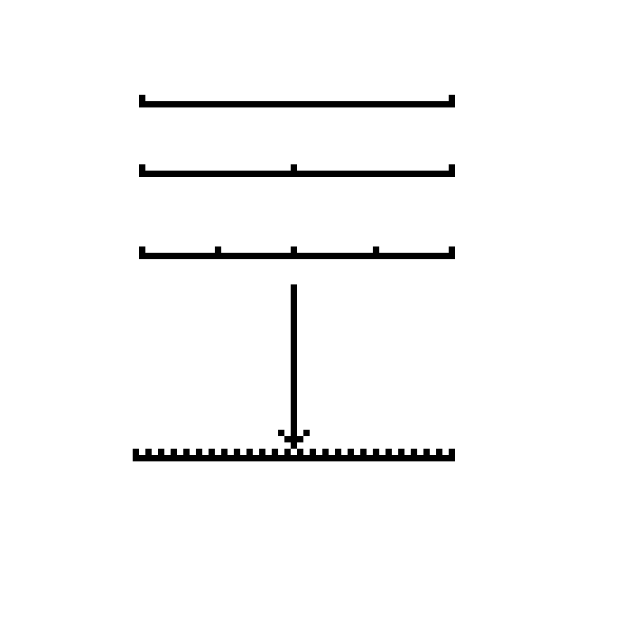
Introduction
It was proposed by A. Bialas and R. Peschanski (Nucl. Phys. B 273 (1986) 703) to study the dependence of the normalized factorial moments
Note: there is a set of
definitions of moments and
cumulants.
of the rapidity distribution on the size δy (Δy/M, M is the number of bins,
Δy is the size of the mid rapidity window, N-number of particles in Δy,
k_{j}-the number of particles in bin j ):
1. if fluctuations are purely statistical no variation of moments as a function of δy is expected
2. Observation of variations indicates the presence of physics origin fluctuations
Δy
M=1
M=2
M=…

Slide 3
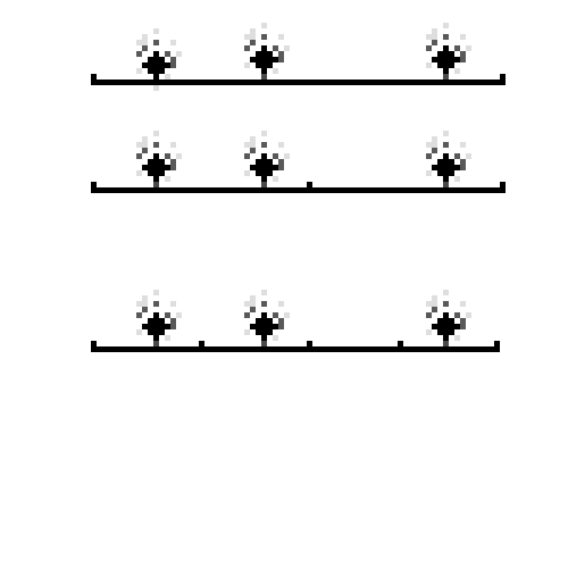
What do we see with factorial moments: simplified case
Let’s imagine that in each event we have an accident number of particles organized in groups and groups are distributed uniformly in Δy interval. Each group has the random number of particles. Let’s imagine that all particles inside group has the same rapidity, i.e. point-like group.
Δy
M=1
Let’s the number of groups per event is Poissonian
and the number of particles per group
has geometrical distribution – Fi(M) can be calculated analytically.
F2(M) = 1 + 2*p*M/Lambda
p – parameter of geometrical distribution
Lambda - the mean number of group
M=4
Fi(M) grows as polinomial of order (i-1) until the width of the rapidity distribution of the particles
within group is larger then size of bin (σ > Δy/M).

Slide 4
Simplified model summary
In the case of pointlike groups (particles are produced at one rapidity point), the factorial moments grow as polinomials with increasing number M of bins in the partition of the initial interval.
In the case of nonpointlike groups (particles are distributed with respect to the group center), the factorial moments at any order tends to a constant when the bin size becomes much less then characteristic width of the group.
If several processes with different characteristic widths are effective, the factorial moments increase until the bin size becomes much less than the smallest characteristic width.
The rate of growth depends on the density of the rapidity distribution of groups, on the multiplicity of particles in the group and on the relative probabilities of processes with different variances of particle distributions within group.

Slide 5
Latest studies in the world: theory and experiments
Intermittency (fluctuations of various different sizes in 1D, 2D and 3D phase space) have been studied at LEP, Tevatron, Protvino in ee, hh, hA, AA interactions at the various energies. There are plenty of interpretations including Clan Model proposed by L. Van Hove, intermittency and fractals of the different origin.
Some latest studies for pp and AA (NA49, NA61, ALICE):
A Monte Carlo Study of Multiplicity Fluctuations in Pb-Pb Collisions at LHC Energies, Ramni Gupta, Journal of Central European Green Innovation 4(4) pp 116-126 (2016)
Search for the critical point of strongly interacting matter in NA49 Katarzyna Grebieszkowa for the NA49 collaboration, arXiv:0907.4101
Scaling Properties of Multiplicity Fluctuations in the AMPT Model Rohni Sharma and Ramni Gupta, AHEP, v2018, AricleID 6283801
Searching for the critical point of strongly interacting matter in nucleus-nucleus collisions at CERN SPS, Nikolaos Davis (for the NA61/SHINE Collaboration), arXiv:2002.06636

Slide 6
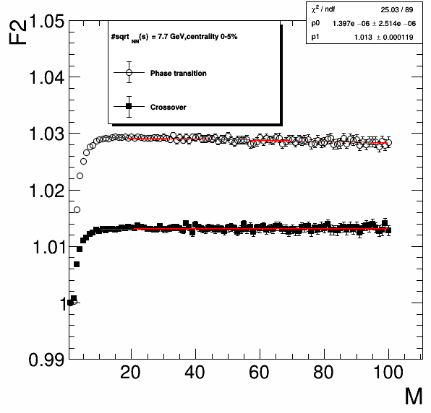
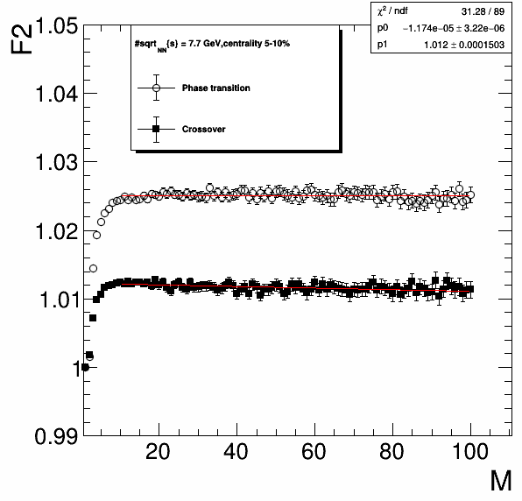
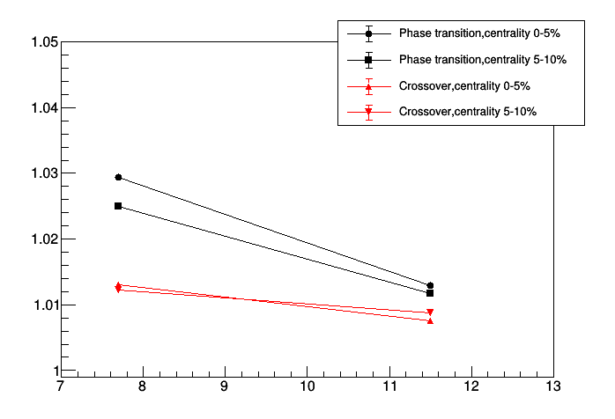
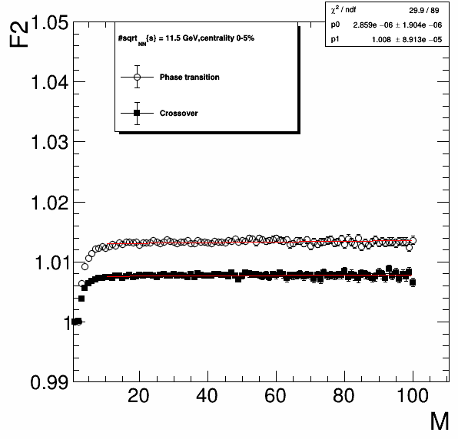
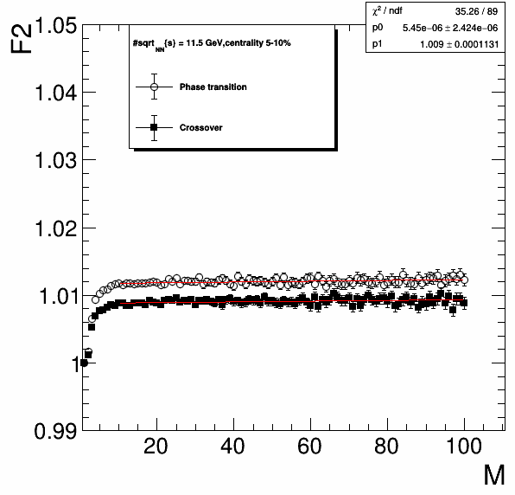
Au-Au, URQMD+VHLLE
7.7 GeV
F2Max
11.5 GeV
Different energy
dependence is
expected for
Crossover and the
1st order phase
transition
E, GeV

Slide 7
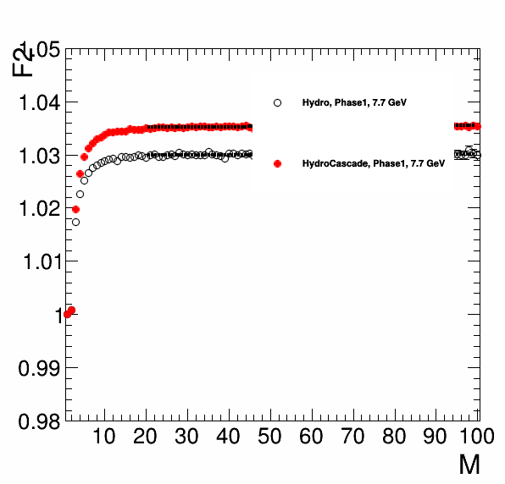
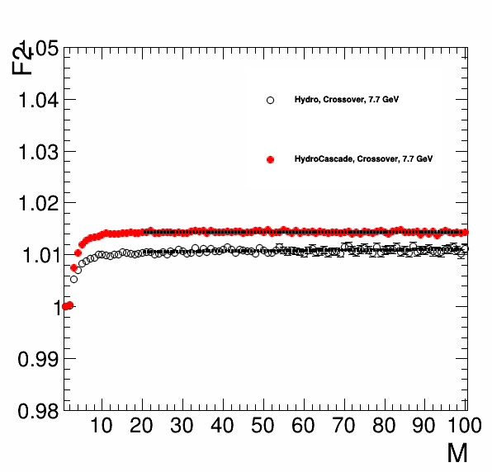
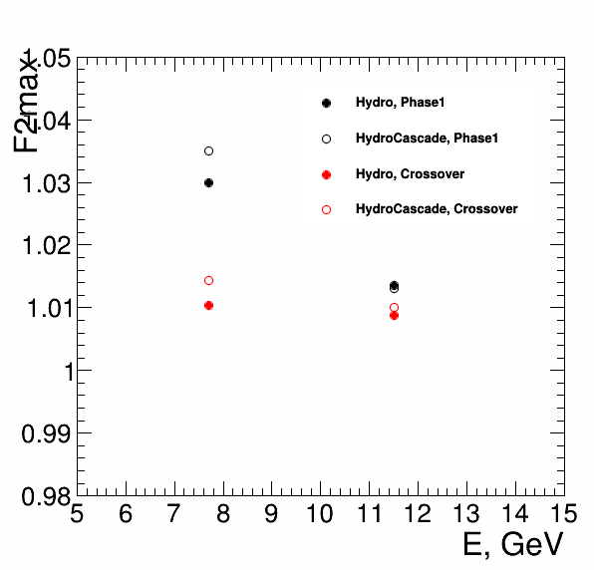
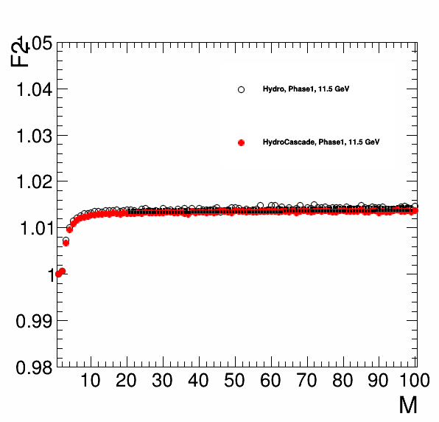
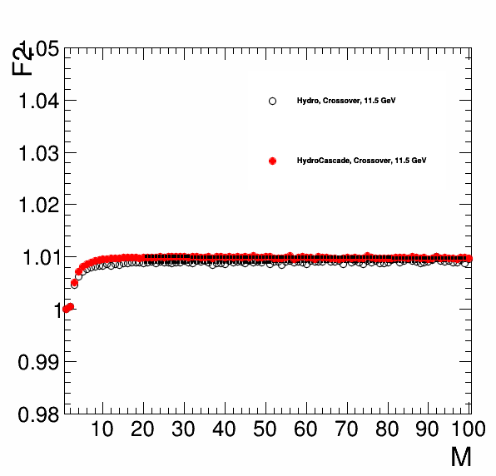
Hydro and HydroCascade separately
There is a small increase of the
F2 maximum for HydroCascade.
w.r.t Hydro only.
However the different trend in the
F2 behaviour for the Phase 1 transition
and crossover is visible

Slide 8
Summary
Normalized factorial moments as a function of the size of the observation interval are sensitive to the type of phase transition.
We observe the different energy behaviour for the Crossover and 1st order phase transition in the frame of the URQMD+VHHLE model.

